Slide 1

DEPARTMENT OF COMPUTER SCIENCE AND ENGINEERING
Project name : Public Transport Optimization
Team name : Proj_224782_Team_4
Team members :
ASHWINI E(113321104006)
BENSIHA A(113321104008)
DEYAA ASMI M(113321104013)
DHANALAKSHMI S(113321104014)

Slide 2
PROJECT DEFINITION
The Public Transport Optimization project aims to enhance the efficiency , accessibility , and sustainability of public transportation systems within a designated urban area.
This project meets the evolving needs of the community while reducing traffic congestion and environmental impact.

Slide 3
OBJECTIVES
Data Collection and Analysis
Route Optimization
Demand-Responsive Services
Sustainability and Electrification
Accessibility and Inclusivity
User Experience Enhancement
Public Engagement
Performance Metrics and Monitoring
Cost-Benefit Analysis

Slide 4
PROJECT REQUIREMENTS
Data Collection and Analysis:Specify the types of data to be collected,including travel patterns,population density,traffic flow,peak travel times, and demographic information.
Route Planning and Design:Define the criteria for designing optimized routes,considering factors like demand, connectivity, accessibility, and operational efficiency.specify the guidelines for determining potential stops, transfer points, and integration with other transportation modes.specify the simulation software or models to be used for testing and optimizing the proposed routes.
Integration with Other Models:Define the requirements for integrating public transport routes with other transportation modes, such as biking, walking, and ridesharing.
Compliance and Regulations:Ensure compliance with relevant local, regional, standards, and policies governing public transport operations and planning.
Risk Management:Define a risk management plan, including identification,assessment, and mitigation strategies for potential risks that may arise during the optimization process.

Slide 5
DEVICE SELECTION
Sensor Selection:
Gos sensors
Automatic passenger counting (apc)sensors
Proximity sensors(passengers’s count is given)
Load sensor
Speed sensor
Temperature and humidity sensor
Fuel consumption sensor
Camera and video surveillance systems
Environmental sensors
Brake and accelerate sensor
Door opening and closing sensor

Slide 6
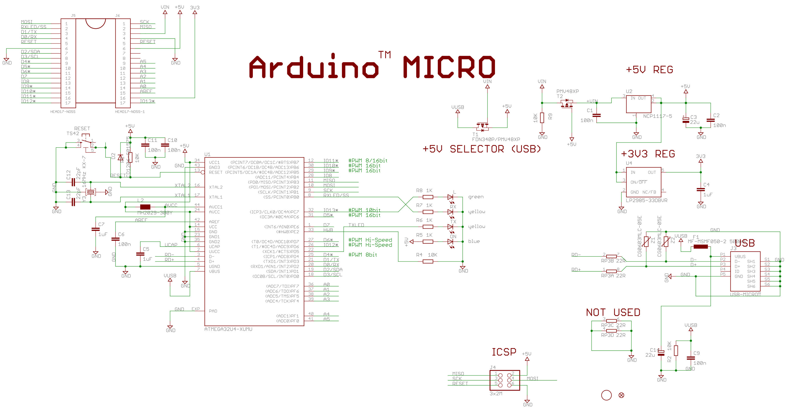
ARDUINO INTEGRATION
This Photo by Unknown Author is licensed under CC BY-SA

Slide 7
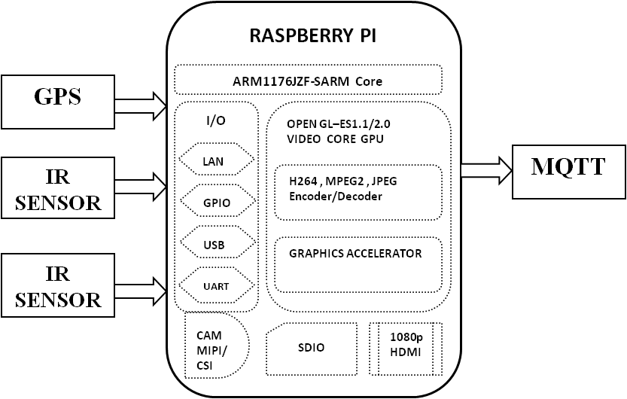
RASPBERRY PI INTEGRATION

Slide 8
CODE IMPLEMENTATION
HARDWARE REQUIREMENTS
SOFTWARE REQUIREMENTS
Raspberry pi
Node MCU ESP8266
GPS
IR sensors
RFID
LCD 16*2
Programming platform:Arduino IDE,python IDE
Programming language:Embedded C,Python
Raspberry pi OS:Raspbian stretch

Slide 9
PYTHON SCRIPT DEVELOPMENT
On IoT Devices:-
On Central Server:-
1. Set Up the Development Environment
2. Import Required Libraries
3. Initialize Device and Sensors
4. Data Collection
5. Data Processing
6. Data Transmission
7. Error Handling
8. Control Logic (If applicable)
9. Logging and Debugging
10. Power Management (If applicable)
11. Testing
12. Documentation
13. Integration with the Central Server
14. Deployment
1. Setting Up the Central Server Environment
2. Importing Required Libraries
3. Data Reception and Storage
4. Data Processing and Analysis
5. Data Visualization
6. User Authentication and Access
Control
7. Error Handling and Logging
8. Remote Device Control Logic
9. Security Measures
10. Automation and Script Execution
11. Testing and Debugging
12. Documentation
13. Integration with IoT Devices
14. Deployment and Scaling

Slide 10
CONCLUSION
This documentation provides a comprehensive overview of the Public transport optimization project,covering objectives,requirements,device selection,Arduino & Rasberry Pi Integration,Python Script Development and code implementation. It also explains how the system promotes transport efficiency and public awareness.

Slide 11
THANK YOU

